Slide 1
Predictive Modeling of Income Levels based on Demographic and Employment Features
ANILA PETER

Slide 2
Problem Statement
The dataset have information related to income evaluation across various countries. Our objective is to construct a predictive model capable of discerning whether an individual's income surpasses a predefined threshold, specifically exceeding 50K. By developing this model, we aim to identify and understand the key factors that contribute to higher incomes. Ultimately, the knowledge gained from this model can provide valuable information for
policymakers, researchers, and individuals seeking to comprehend the determinants of financial success across diverse geographic and demographic contexts."

Slide 3
Data Dictionary
Age: The age of an employee
Work-class: Profession category
Final_census : Census(population of the country)
Education: Type of last (max) Education
Education_num: Years spend on studies
Marital Status: Person married or not
Occupation: Person
Relationship: Bounded by any relation or dependent
Race: which ethnicity belongs to the employee
Gender: gender of the employee

Slide 4
Data Dictionary
Capital-gain: Capital gain refers to the profit earned when selling a capital asset, such as stocks, real estate, or valuable possessions. It represents the difference between the selling price of the asset and its original purchase price.
Capital-loss: Capital loss refers to the financial loss incurred when selling a capital asset at a price lower than its original purchase price. It represents the negative difference between the selling price and the purchase price of the asset.
Hours/week : How many working hours in a week
Country : Country where it belongs
Income threshold(Target Column) : two range of Income one is <=50k and >50K

Slide 5
Income Classification
The problem is a binary classification problem.
The two classes in the target column are:
Income <=50K
Income >50K

Slide 6
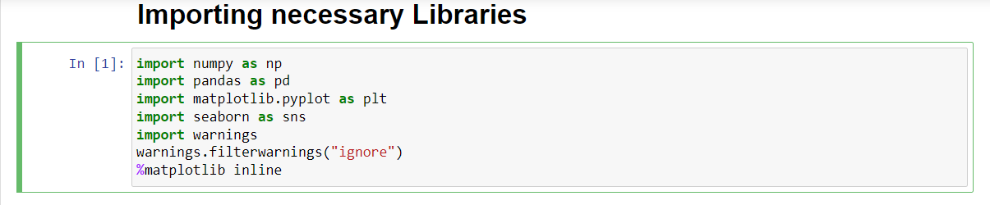
Importing necessary Libraries

Slide 7
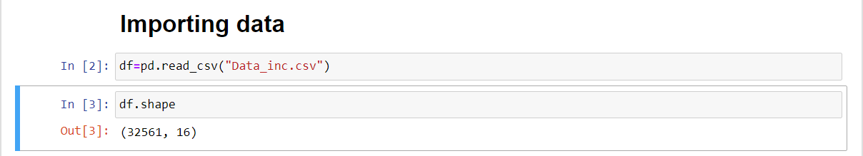
Importing data
The dataset has 32561 rows and 16 columns

Slide 8
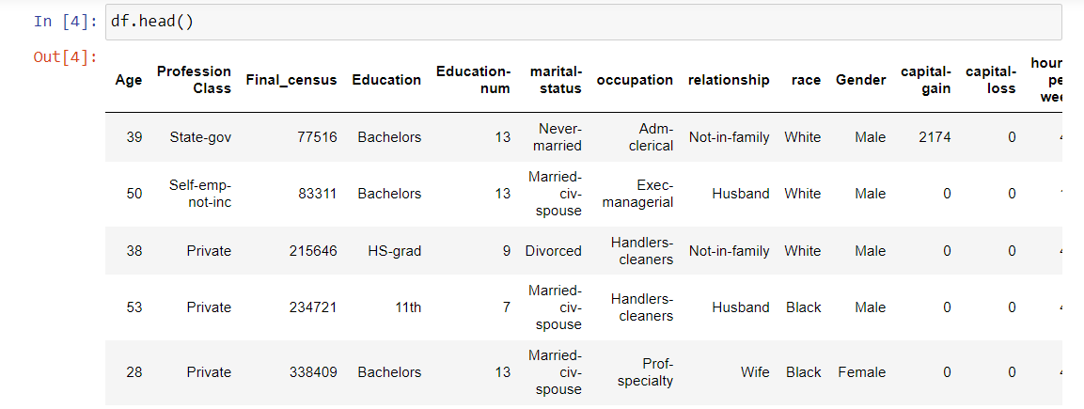
First few rows of the dataset

Slide 9
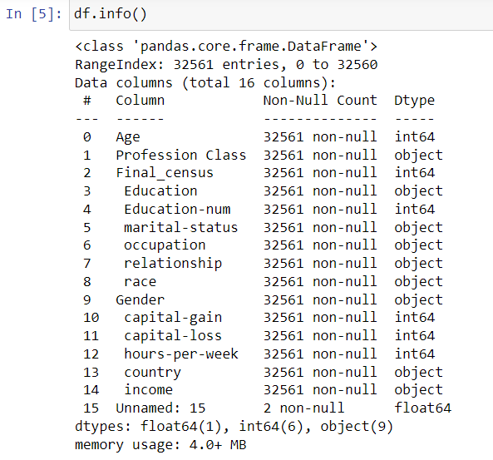
There is only 2 non-null values in the column "Unnamed: 15". So we will drop it.

Slide 11
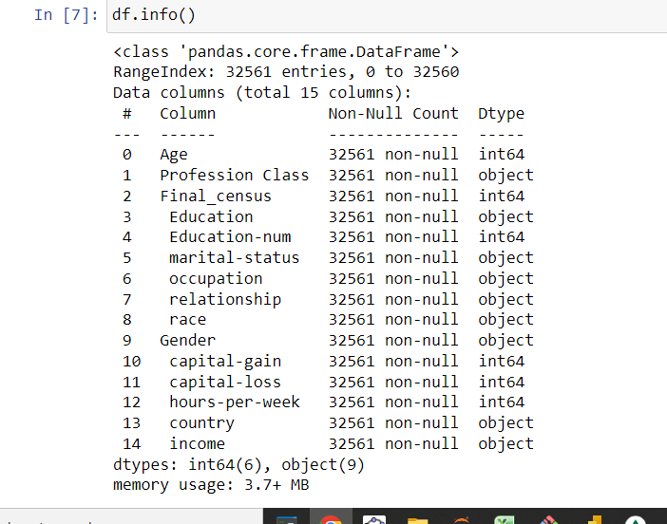
Now there are 15 columns. All the columns has of datatype either object or int64. Also all 32561 rows in all columns has non-null values..

Slide 12
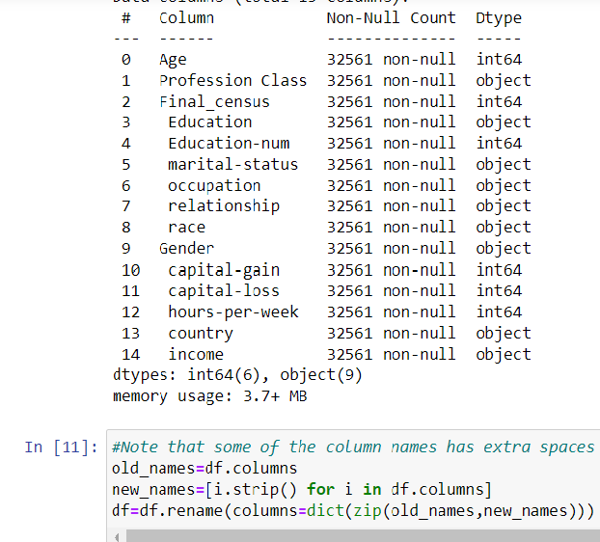
Note the extra spaces in the colume names.
We will remove them.

Slide 13
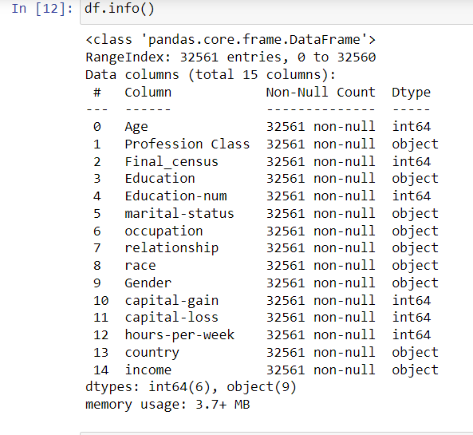
Extra spaces removed!!

Slide 14
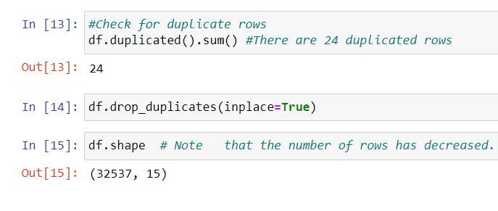
Checking duplicate rows.
There are 24 duplicate rows.
Removing them reduces the number of rows!!

Slide 15
Exploratory Data Analysis

Slide 16

For convenience, we make separate lists of numerical and categorical columns using their data types .

Slide 17
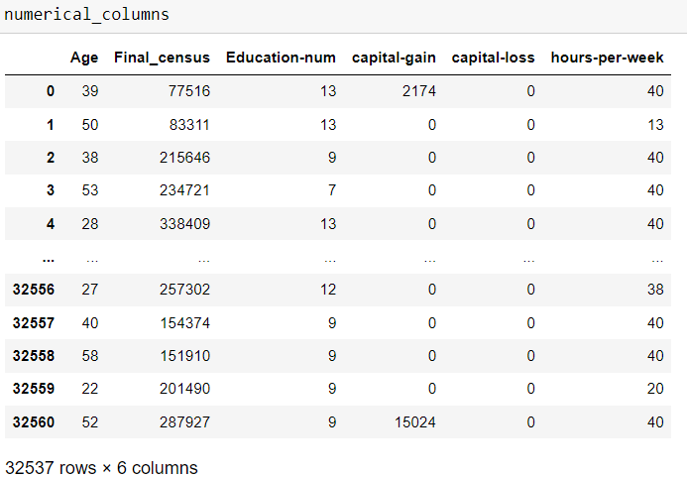
There are 6 numerical columns

Slide 18
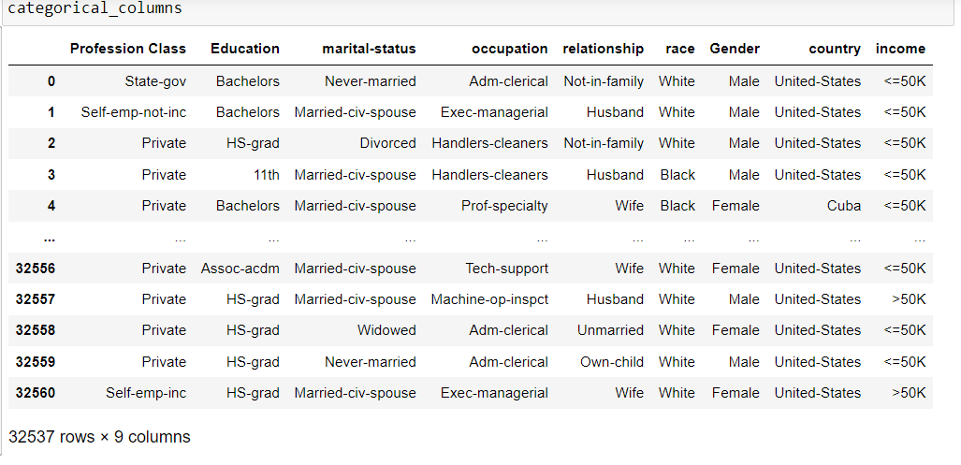
There are 9 categorical columns

Slide 19
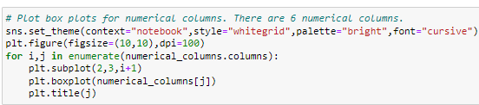
Plot the Box plots of numerical columns

Slide 20
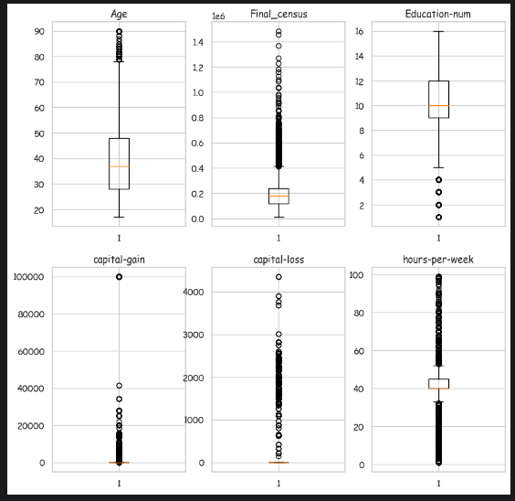
There are outliers in all the numerical columns. In the columns of 'capital-gain' and 'capital loss' most of the values (almost 75%) are '0'.

Slide 21
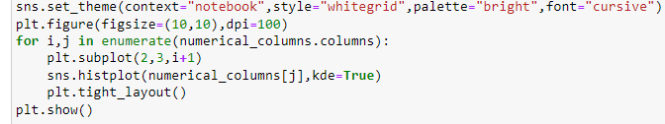
Plot the Histplots of numerical columns

Slide 22
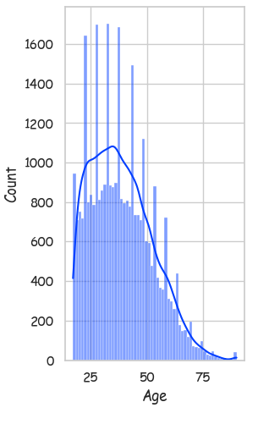
Histogram of column ‘Age’ is shown and it is right skewed.
The count is decreasing as Age is increasing
Most of the people included are of age between 25-50

Slide 23
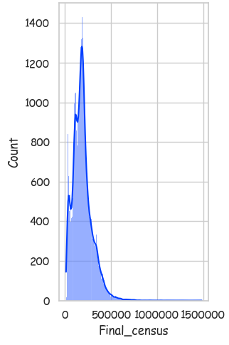
Histogram of column ‘Final_census’ is shown and it is right skewed.

Slide 24
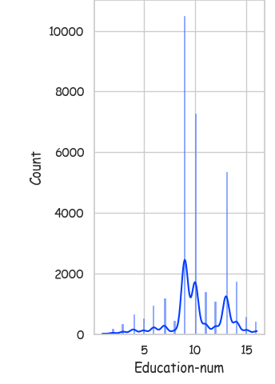
Histplot of column ‘Education_num’ is shown.

Slide 25
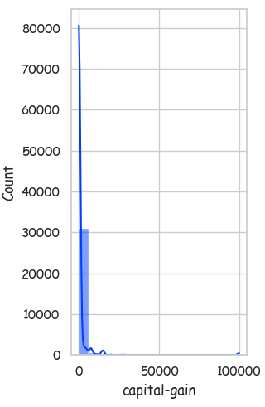
Histplot of column ‘capital-gain’ is shown and it is extremely right skewed.
Large majority of values in the column is ‘0’.
There are very few values as high as 100000
Difference between the values is very high (Scaling is required!)

Slide 26
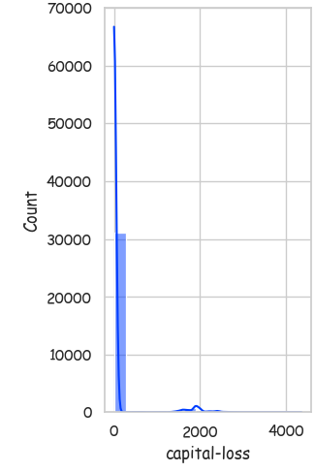
Histplot of column ‘capital-loss’ is shown and it is extremely right skewed.
Large majority of values in the column is ‘0’.
There are very few large values
Difference between the values is very high (Scaling is required!)

Slide 27
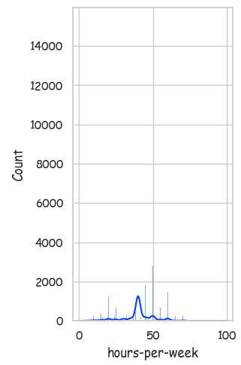
Histplot of ‘hours-per_week’ is shown and it is nearly symmetrical.
Mode is at about 40.
That is, most of the people have 40 hours of work per week.

Slide 28
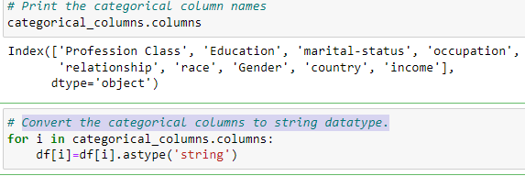
Convert the categorical columns to string datatype
.

Slide 29
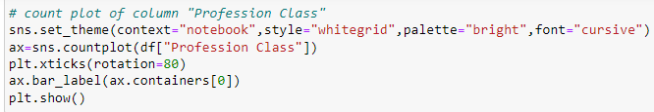
Plot the countplots of categorical columns
.

Slide 30
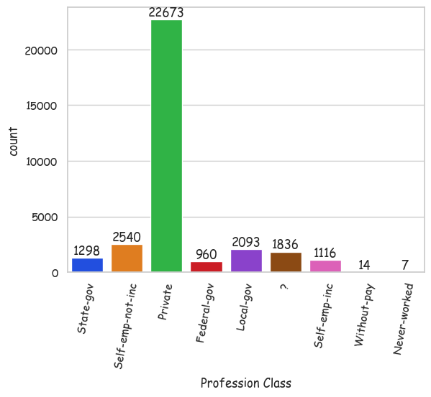
Note that one of the bar in the above countplot is labeled as '?'. 1836 values in the column 'Profession Class' are missing and has to be treated.
Majority of the people work in private sector.

Slide 31
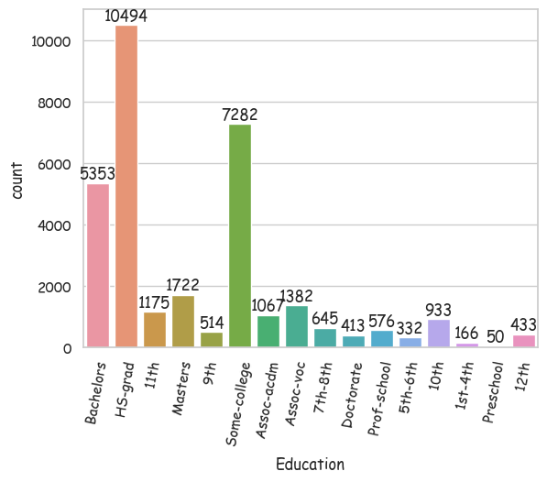
The education column has 16 categories.
Most of the categories can be grouped to reduce the number of categories.

Slide 32
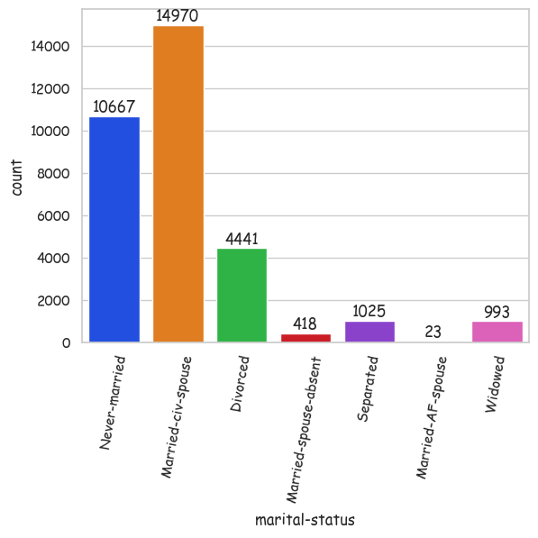
Most of the people have 'marital-status' as 'Married-civ-spouse' and least have 'Married-AF-spouse'.
‘Divorced’, ‘Married-spouse-absent’, ‘Separated’ and ‘Widowed’ can be combined one category ‘No spouse now’.

Slide 33
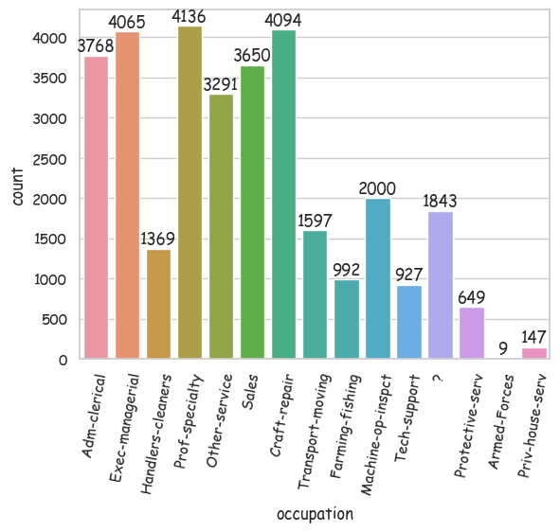
Note that one of the bar in the above countplot is labeled as '?'. 1843 values in the column 'occupation' are missing and has to be treated.
This column has more missing values than that of 'Profession Class'.

Slide 34
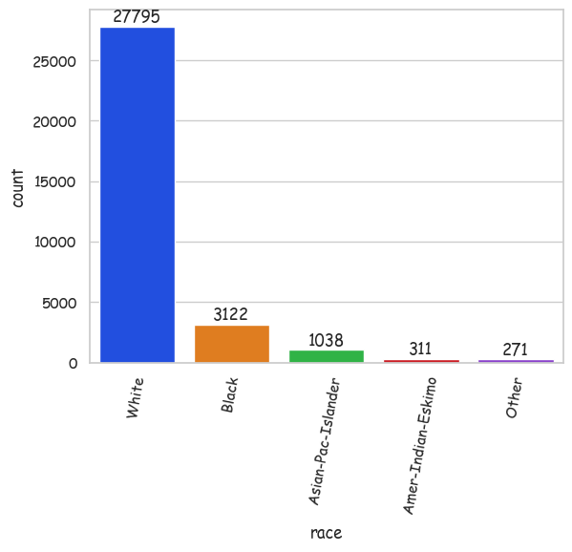
Majority of people included have race 'White'.
Dataset is certainly biased.

Slide 35
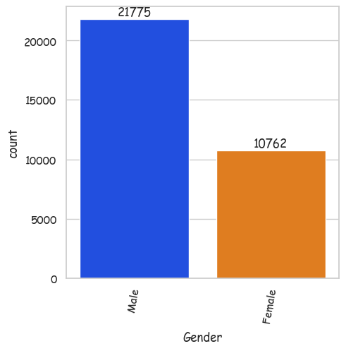
Number of males is way more than number of females.

Slide 36
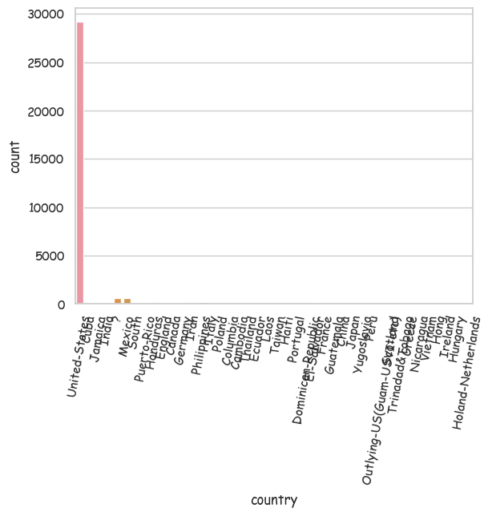
Majority of people included are from United-States
There are missing values in this column 'country' and has to be treated.

Slide 37
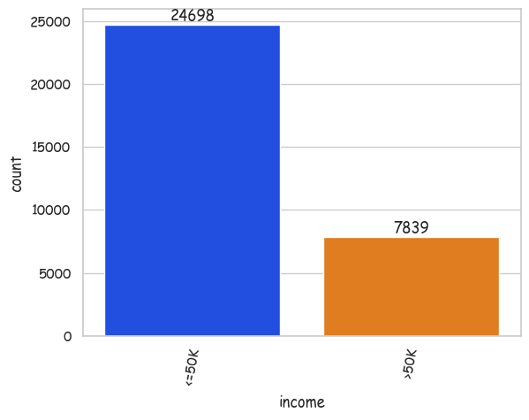
The countplot represents the target column income.
The bars are of very different heights and so the data is highly imbalanced. So we will use stratified sampling while splitting train and test data

Slide 38
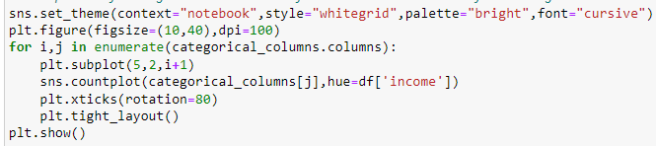
Plot the countplots of categorical columnson the basis of the target column.

Slide 39
All categories in 'Profession Class' has people with income >50k.
Note that some people with 'Profession Class‘ category ‘?’ also has income >50K
So dropping the rows with missing values will increase the imbalance of Target column

Slide 40
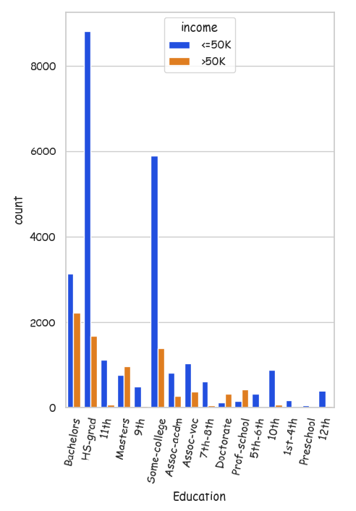
More people with 'Education' Masters/Doctorate/Prof-school has income >50k than income <=50k.
Also, note that even some HS-grads has income >50k.
But only few school dropouts has income >50k.

Slide 41
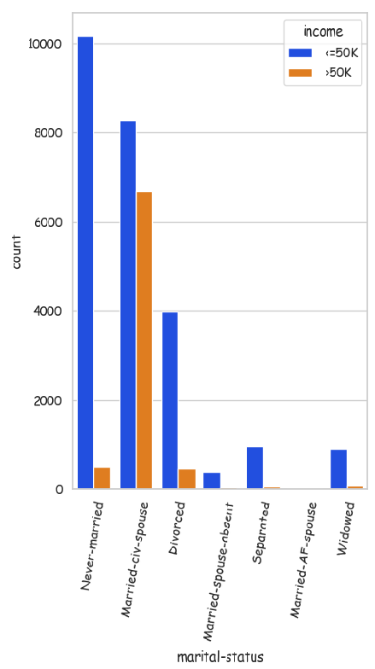
The category in 'marital-status' married-civ-spouse has more proportion of people with income >50k.

Slide 42
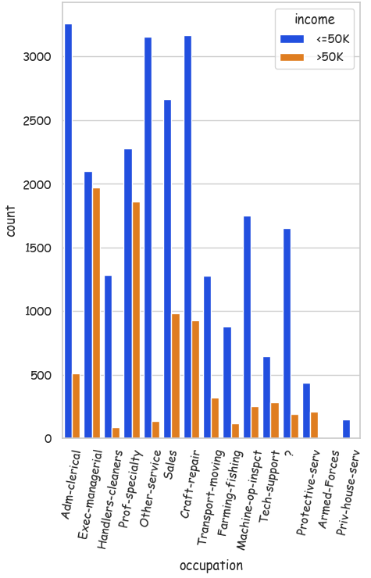
'Occupation' exec-managerial or prof-speciality has highest ratios of people with income >50k.
Missing value category also has some people with income >50k.

Slide 43
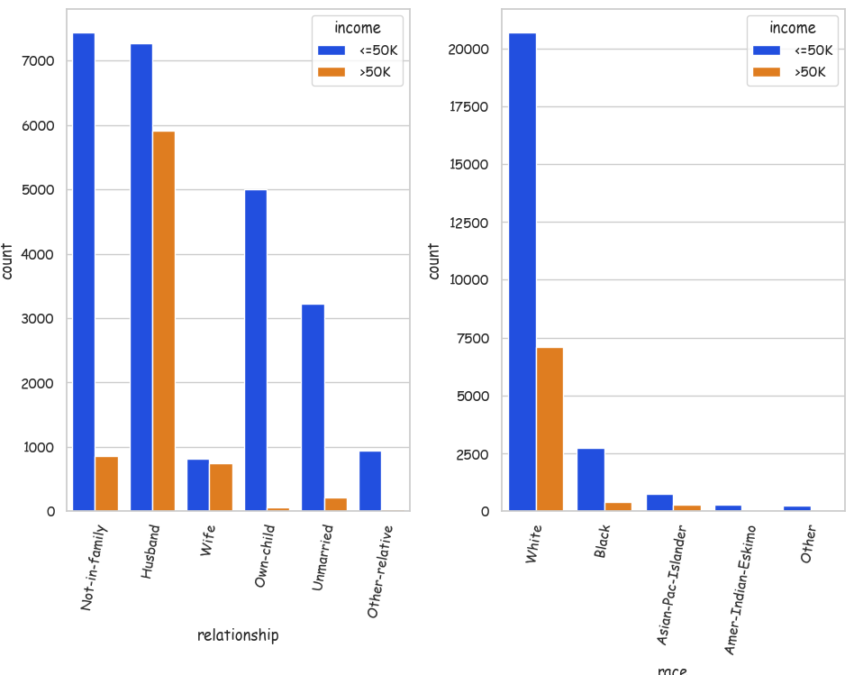
If the relationship in family is either ‘Husband/Wife’, the chances of earning more than 50K is high.
A person has high chance of earning >50K in case the race is ‘White’/’Asian-pac-islander’.

Slide 44
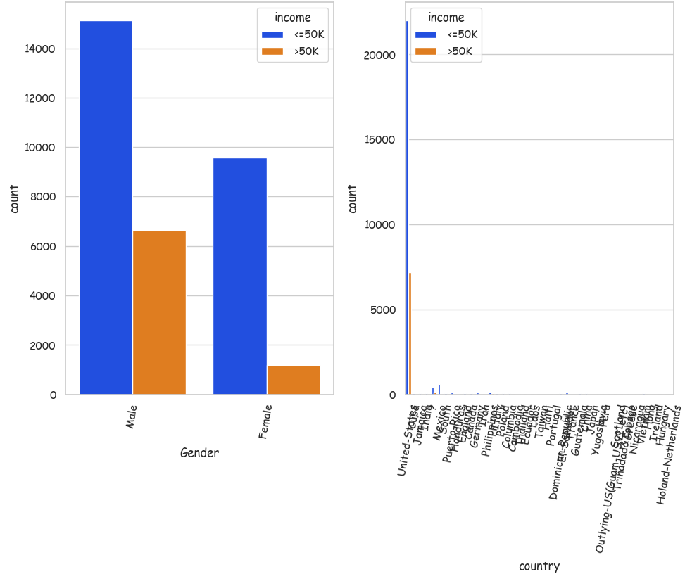
Males have a higher chance of earning more than 50K, than females.
The missing value category '?' has rows with income >50k.

Slide 45
Pairplot of numerical columns based on target column.

Slide 46
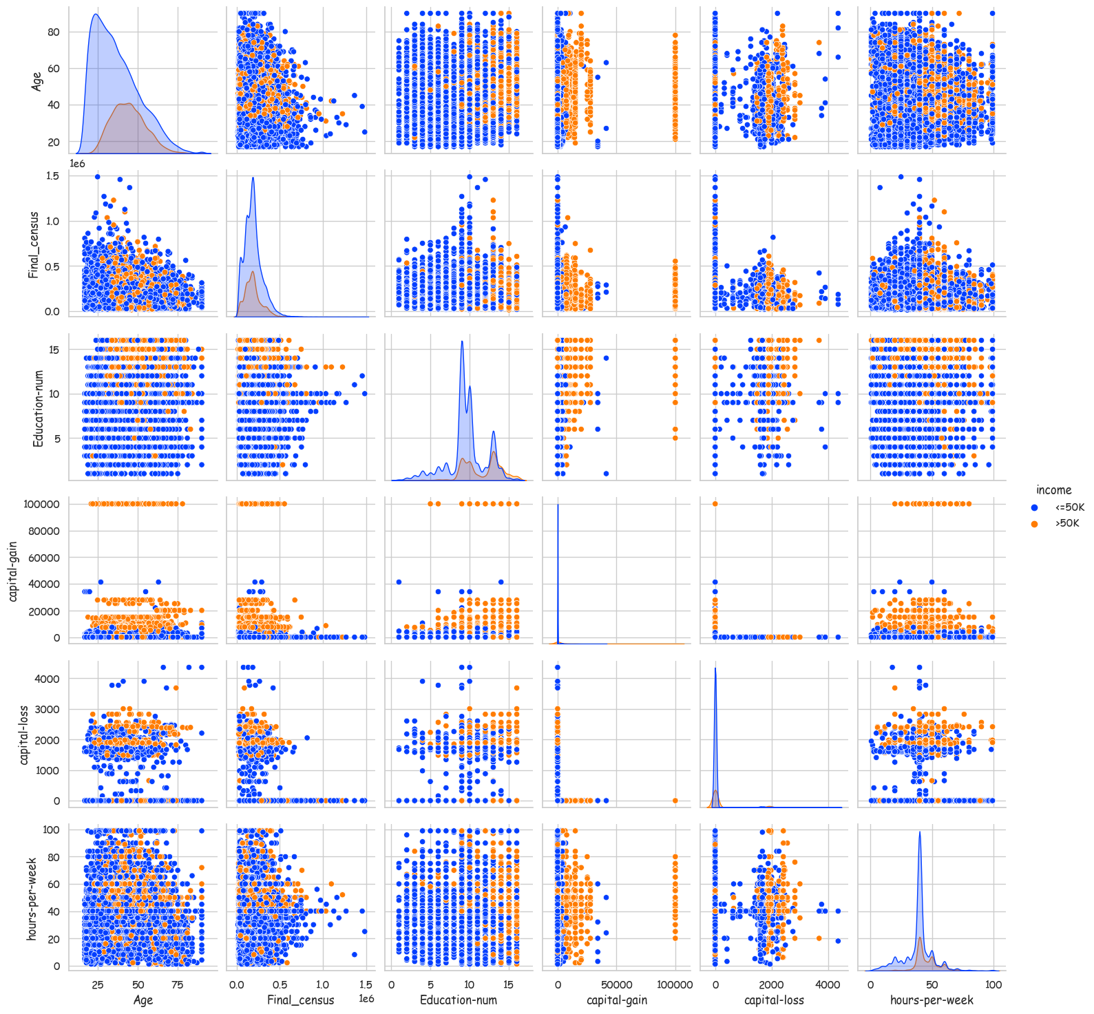

Slide 47

Use a heat map to get an idea of correlation between numerical columns.

Slide 48
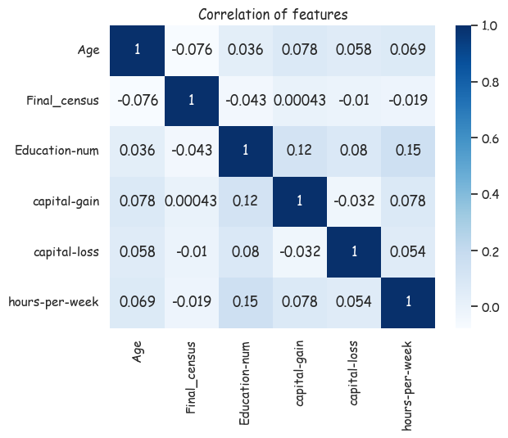
Correlations between numerical columns are weak

Slide 49
Pre-processing and cleaning

Slide 50
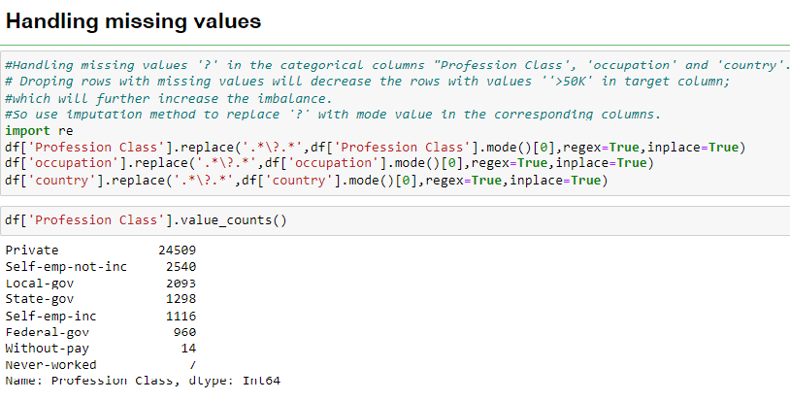

Slide 51
Combining categories

Slide 52
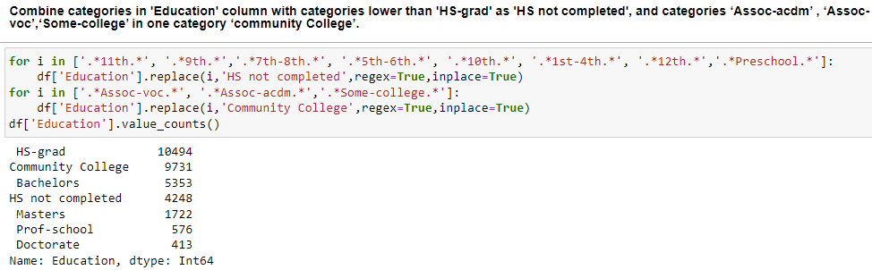

Slide 53
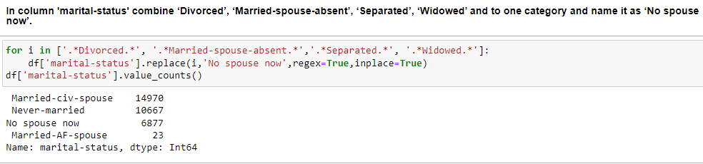

Slide 54
Outlier Treatment

Slide 55
There are outliers in all the numerical columns.

Slide 56
All numerical columns has outliers. So removing the rows with outliers will result in information loss. Looking closely at the dataset, it can be noticed that these outliers are not due to error. The extremely large values in capital-loss and capital-gain may decide the income category and so should not be removed or replaced. So we will keep it unchanged.

Slide 57
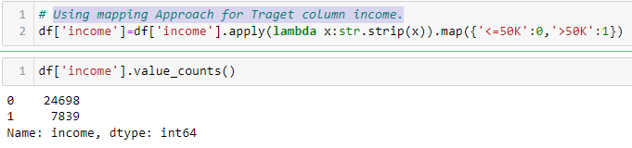
Use mapping Approach for encoding Traget column ‘income’.

Slide 58

Using One hot encoding for other categorical columns.

Slide 59
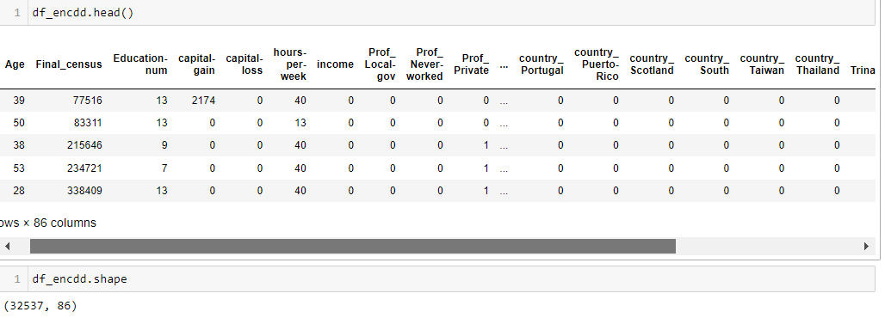
Data after encoding

Slide 60

Separating the dependent variable (Target) and independent variables (Features)

Slide 61
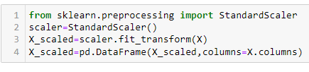
Scaling the data

Slide 62
Train-test split
Since the target column is imbalanced we use Stratify.

Slide 63
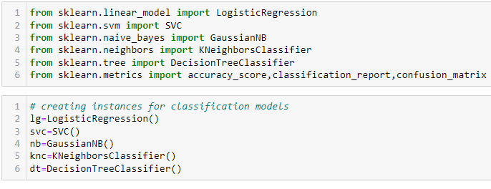
Importing classification models and metrics

Slide 64
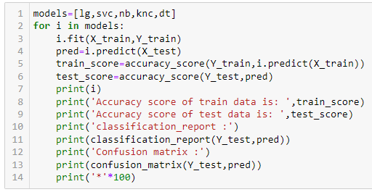
Fitting models and checking classification metrics

Slide 65
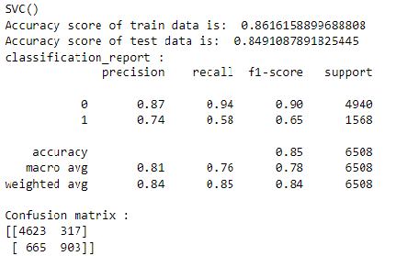
The accuracy score for test data is highest for SVC.

Slide 66
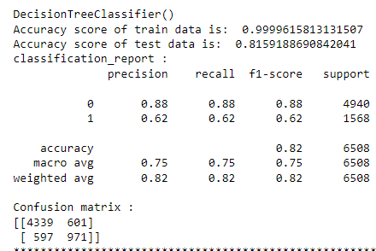
DecisionTreeClassifier() overfits the data: has accuray score 99.99% for train data, but only 81% for test data.

Slide 67
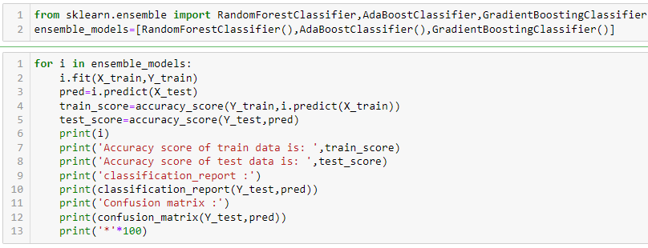
Trying ensemble classification models

Slide 68
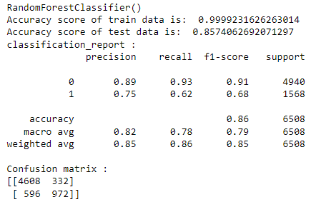
RandomForestClassifier() overfits the data: has accuray score 99.99% for train data, but only 85.7% for test data.

Slide 69
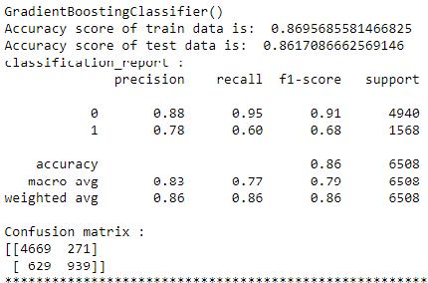
GradientBoostingClassifier() gives the highest accuracy score about 86% for test data and about 87% for train data. So, we choose GradientBoostingClassifier() as the final model.

Slide 70

Cross validation
Mean accuracy scores are all close to 86% and so we can conclude that there is no overfitting.

Slide 71

Hyperparameter Tuning
List of parameters of GradientBoostingClassifier

Slide 72


Slide 73

Saving the model
Model saved as a joblib file ‘income_classifier’.
The accuracy is about 87%

Slide 74

Actual and predicted values

Slide 75
This marks the end of the project; we have successfully trained our model to predict the income of a person, with an accuracy of ~87%.
We moved step by step, analyzing, cleaning and modeling the data, and applied various machine learning models to achieve the desired predictions. We also tuned the model to improve the accuracy, and were able to achieve a model with quite a good accuracy.

Slide 76
Thank You

